Slide 1
Evaluation of Style Advisor Performance
Comprehensive Analysis and Insights

Slide 2
Introduction & Objectives
Overview: This project evaluates the Style Advisor performance across various regions based on specific criteria.
Objectives:
Analyze evaluation scores
Identify top and bottom performers
Recommend improvement strategies

Slide 3
Data Overview
Data Columns:
Zone, Store Name, Evaluation Criteria Scores (e.g., Store Ambiance, Discovery, Closure & Care)
Overall Evaluation_Score
Structure: Each row represents an evaluation.

Slide 4
Performance Grading
Grading Scale:
High Performer: 90% and above
Average Performer: 70% - 89%
Low Performer: 50% - 69%
Bottom Performer: Below 50%
Example: An advisor scoring 92% is classified as a High Performer.

Slide 5
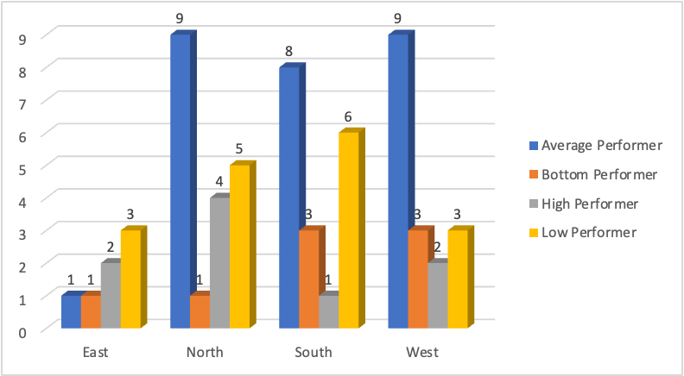
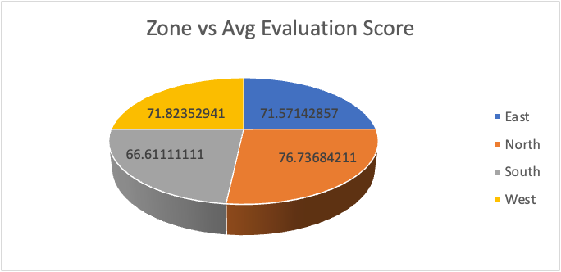
Pivot Table Analysis
Pivot Table:
Rows: Zone
Values: Average Evaluation_Score
Key Observations:
Highest average performers observed in North and West zone.
Lowest average performers in East
North zone has the highest and south has the lowest average evaluation score.

Slide 6
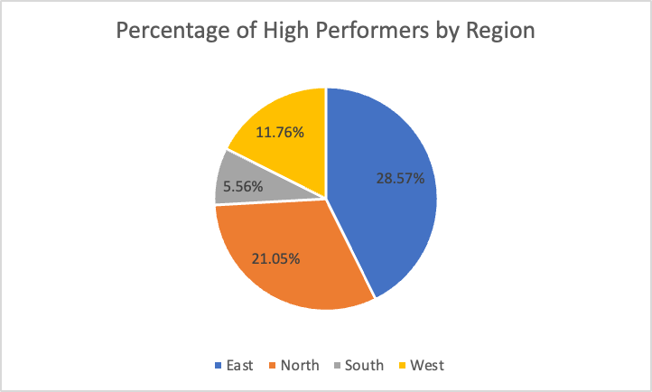
High Performer Analysis
Pie Chart showing percentage of High Performers by Region.
Region Highlight: East with the highest percentage of High Performers.

Slide 7
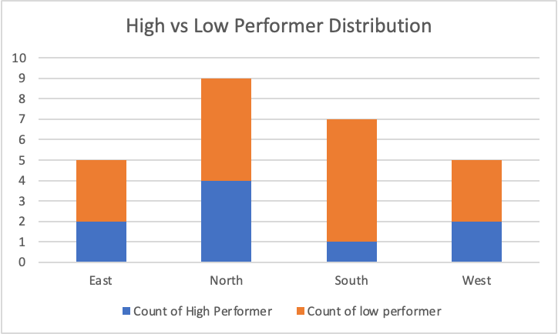
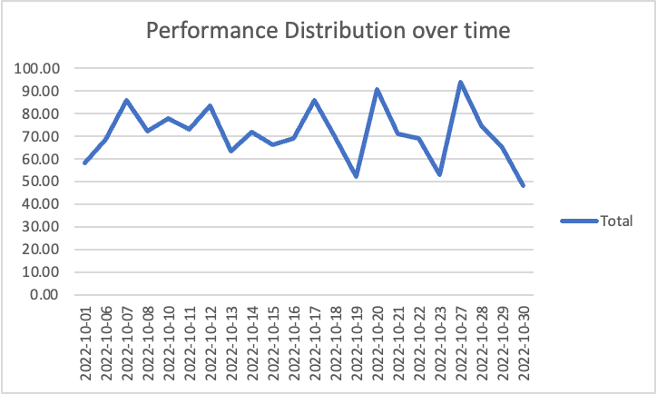
Visualizations
Bar Chart: Average Evaluation Scores by Zone
Pie Chart: Percentage of High Performers by Region
Line Graph: Performance Trends Over Time
Heatmap: Average Scores Across Evaluation Criteria
Stacked Bar Chart: High vs. Low Performers Distribution
Row Labels | Sum of Average Score
Closure & Care | 55.16
First Impressions | 82.59
Store Ambiance | 88.82
The Experience & Upsell | 65.36
Grand Total | 291.93

Slide 8
Key Insights
High-performing region: North Zone (most number of high performers)
Lower-performing region: South Zone (most number of low performers)
Trend Analysis:
2022-10-27: Highest performance
2022-10-19: Decline observed
Performance Category Distribution:
Majority High and Average Performers
Minority Low and Bottom Performers

Slide 9
Recommendations
Strengthen training programs in lower-performing zones.
Recognize and replicate best practices from high-performing zones.
Monitor trends monthly to adjust strategies.

Slide 10
Conclusion
Findings recap: Strengths, opportunities, and performance distribution.
Next Steps: Implement action plans, regular follow-ups, and continuous improvement initiatives.

Slide 11
Q&A
Thank you!
Open floor for questions and discussions.

